Slide 1

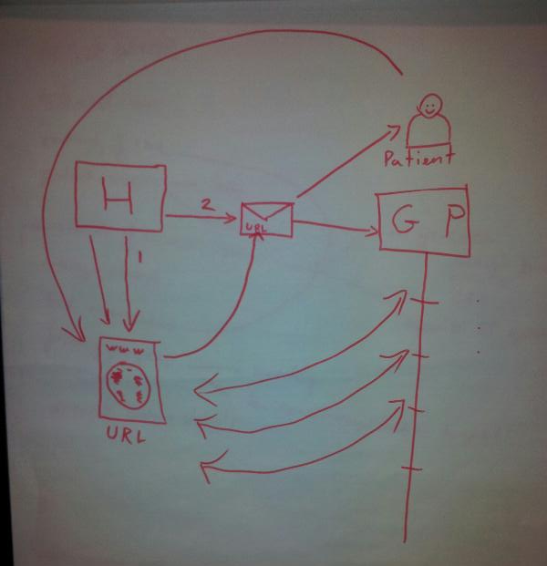
Active Letter
Continuity of Care on discharge
Charles Crichton, Andrew Tsui, Grant Vallance, Jonathan Kay, Jim Davies,
Etienne Saliez, Anna Ellis (GP Consultant)
Shared care. Hospital Consultants. GPs. Patient access. Task management – progress. Links to guidance, policy, how tos, support groups. Accurate contact details. Electronic version of letter content. Tagging.

Slide 2
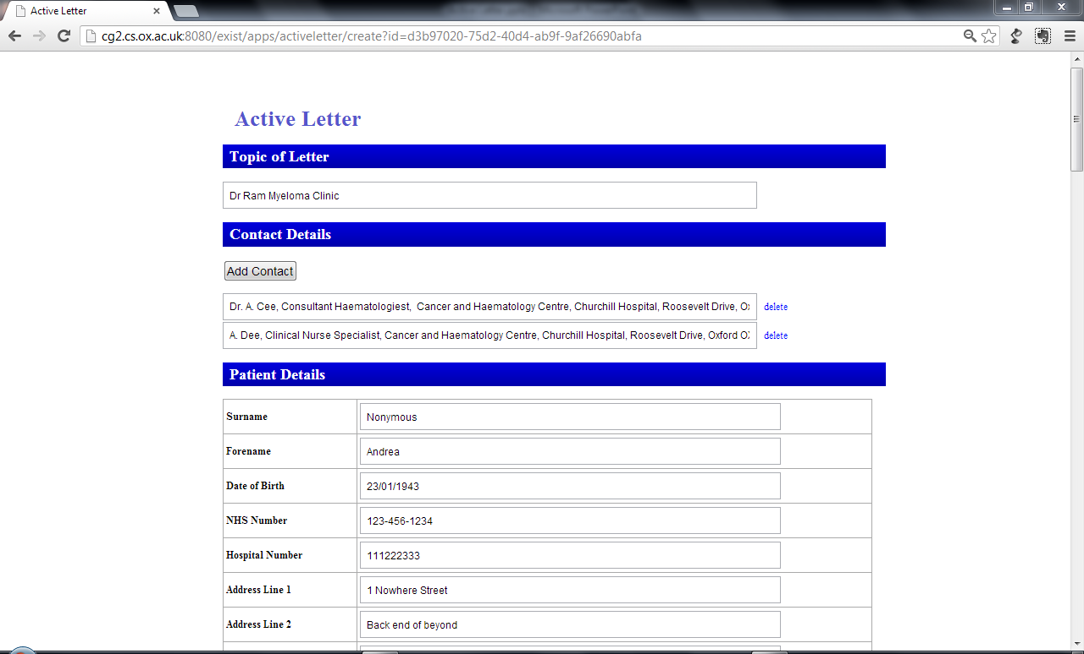

Slide 3
